Slide 1
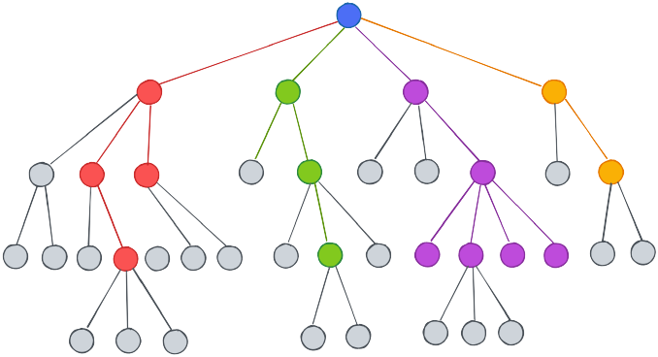
Software Project Lab-1
Topic : Classification of Data Using Decision Tree and Random Forest Based on
Three Different Criteria
Name : Pronob Karmoker
BSSE 1431
Supervisor :
Dr. Muhammad Shoyaib
Professor ,
Institute of Information and Technology,
University of Dhaka.

Slide 2
Project Outline
This project focuses on the application of advanced classification methods utilizing decision trees and random forests. Our goal is to explore three distinct splitting criteria: Entropy, Gini Index, and Hellinger Distance, to enhance the accuracy and effectiveness of classification tasks. The project is designed to cover the following key components:
1. Splitting Criteria:
- We will evaluate and compare three different splitting criteria: Entropy, Gini Index, and Hellinger Distance. These criteria serve as the foundation for effective decision-making in classification tasks.
2. Classification Metrics:
- To assess model performance, we will employ various classification metrics. This includes Cross Validation for model robustness, Precision to evaluate accuracy on positive predictions, Recall to measure the model's ability to identify actual positive instances, and Accuracy calculation & F-Score to gauge overall accuracy and the balance of precision and recall.
3. Decision Tree:
- We will build three distinct decision trees, each utilizing one of the specified splitting criteria. By calculating gains using these criteria and considering the provided classification metrics, we will identify the most suitable starting point for each decision tree.
4. Random Forest:
- The Random Forest technique will be applied, creating an ensemble of decision trees. These trees will work collaboratively, leveraging various splitting criteria, and their results will be combined to provide accurate and reliable classification outcomes.

Slide 3
Progress till today…

Slide 4
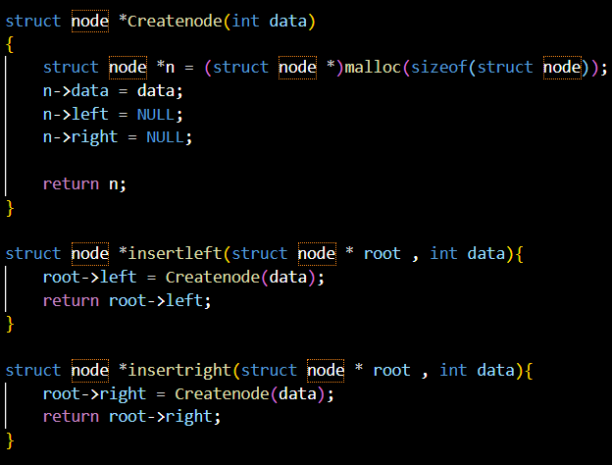
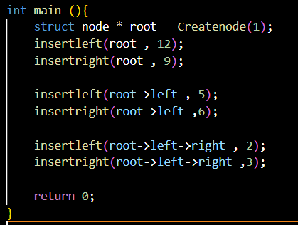
BINARY TREE
A binary tree is a hierarchical data structure composed of nodes, where each node has at most two children, which are referred to as the left child and the right child. Each node in a binary tree contains data and references to its left and right children. The topmost node in the tree, known as the root, serves as the starting point for traversal.
Note: This topic was the focus of my first assignment.

Slide 5
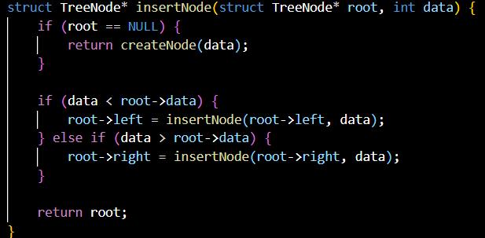
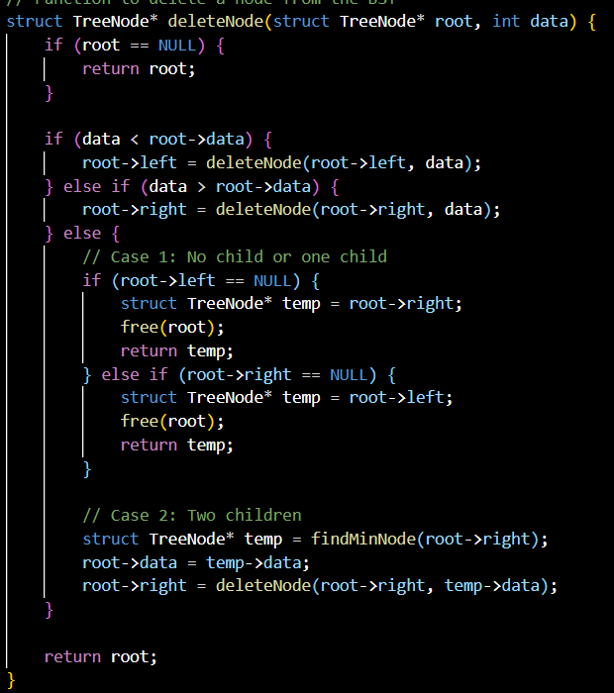
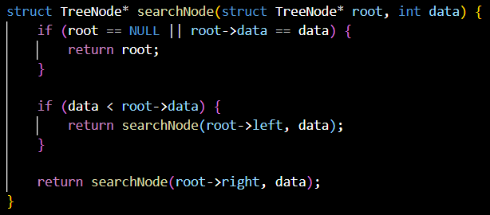
BINARY SEARCH TREE
A Binary Search Tree (BST) is a binary tree data structure in which each node has at most two children, referred to as the left child and the right child. The key property of a BST is that the values (or keys) of nodes in the left subtree are strictly less than the value of the node itself, and the values in the right subtree are strictly greater. This structural arrangement allows for efficient searching, insertion, and deletion operations.
Note: This topic was the focus of my second assignment.

Slide 6
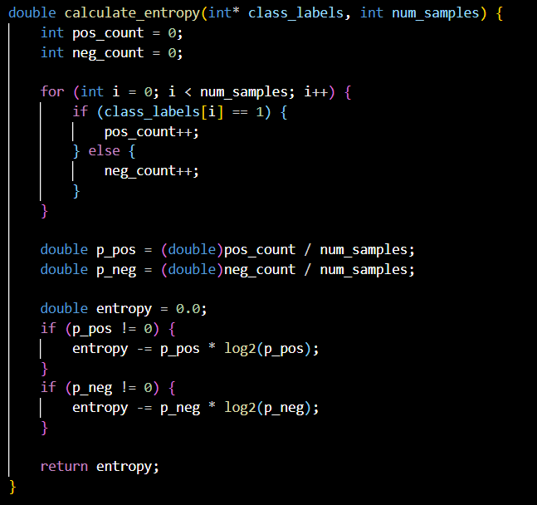
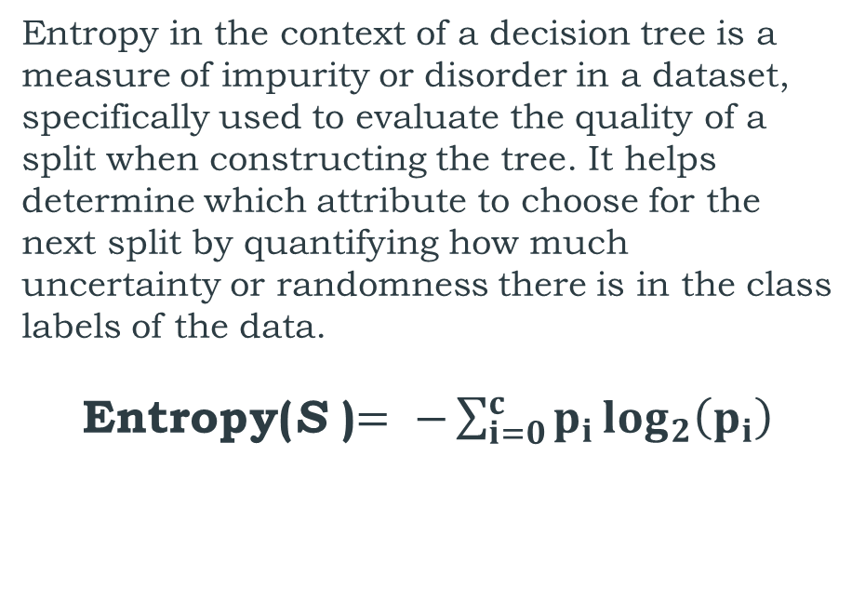
ENTROPY
Entropy in the context of a decision tree is a measure of impurity or disorder in a dataset, specifically used to evaluate the quality of a split when constructing the tree. It helps determine which attribute to choose for the next split by quantifying how much uncertainty or randomness there is in the class labels of the data.
Entropy(S )$= −\sum_{i=0}^{c}{p_{i}\log_{2}\left(p_{i}\right)}$

Slide 7
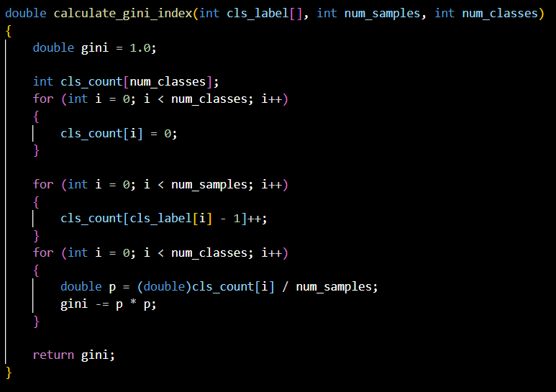
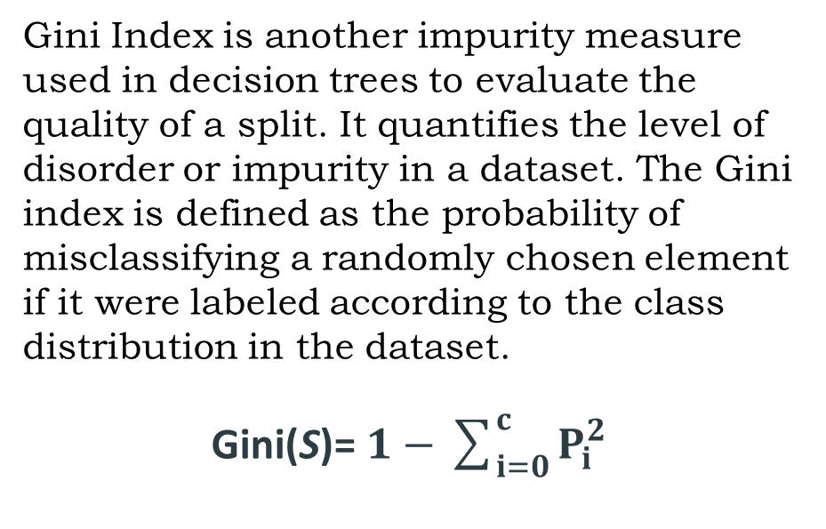
GINI INDEX
Gini Index is another impurity measure used in decision trees to evaluate the quality of a split. It quantifies the level of disorder or impurity in a dataset. The Gini index is defined as the probability of misclassifying a randomly chosen element if it were labeled according to the class distribution in the dataset.
Gini(S)=​ $1−\sum_{i=0}^{c}{P_{i}^{2}}$

Slide 8
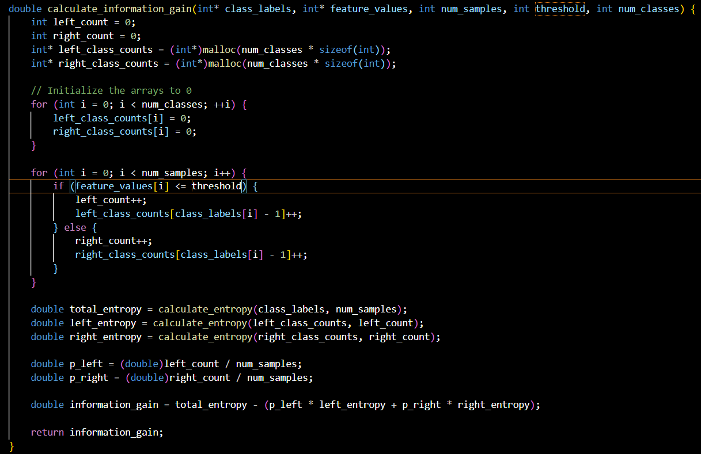
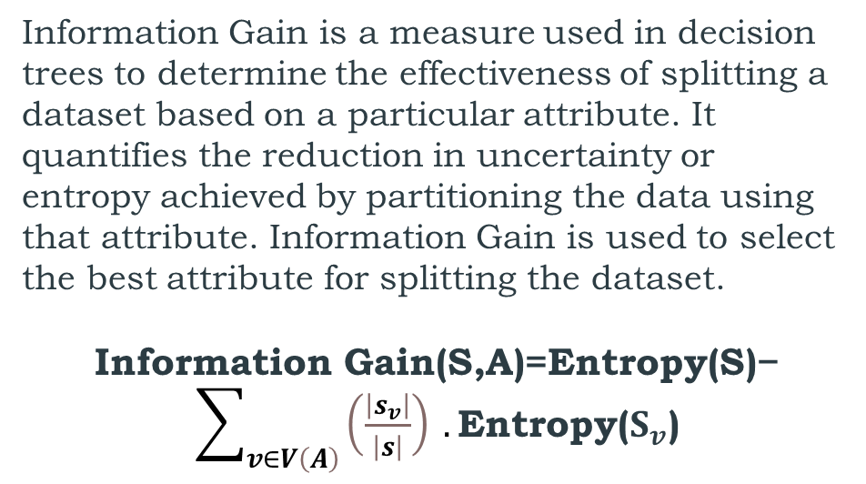
INFORMATION GAIN
Information Gain is a measure used in decision trees to determine the effectiveness of splitting a dataset based on a particular attribute. It quantifies the reduction in uncertainty or entropy achieved by partitioning the data using that attribute. Information Gain is used to select the best attribute for splitting the dataset.
Information Gain(S,A)=Entropy(S)− $\sum_{v∈V\left(A\right)}{\left(\frac{\left|s_{v}\right|}{\left|s\right|}\right)} .\text{Entropy}\text{(}S_{v}\text{)}$
Information Gain = Total Entropy - (Weighted Average of Left Entropy + Weighted Average of Right Entropy)
NOTE: We can utilize this formula in place of the entropy formula when calculating the Gini Index.

Slide 9
Decision Tree
A decision tree is a hierarchical, non-parametric supervised learning algorithm used for classification tasks. It comprises a tree-like structure with a root node, branches, internal nodes, and leaf nodes. Each internal node represents a decision based on a feature, leading to one of its child nodes, while each leaf node represents a class label or a regression value. Decision trees are constructed to optimize decision-making by partitioning the data based on specific criteria, typically to maximize information gain or minimize impurity measures such as Gini Index or Entropy. They offer an interpretable way to make predictions by following a path from the root to a leaf node, making them valuable for understanding and explaining the underlying factors influencing a particular outcome.
In this project, decision trees play a central role in classification tasks, where they use various splitting criteria like Entropy, Gini Index, or Hellinger Distance to determine the best features and thresholds for data partitioning. These trees can also serve as building blocks for Random Forests, an ensemble method that combines multiple decision trees to improve predictive accuracy and robustness.

Slide 10
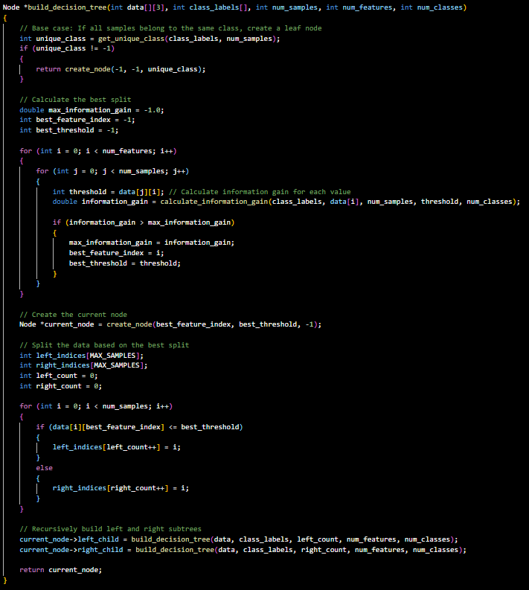
BUILD DECISION TREE
Procedure: Building a Decision tree
Base Case Check: First, we check if all the samples in our dataset belong to the same class. If they do, we create a leaf node in the decision tree representing that class.
Finding the Best Split: If the samples don't all belong to the same class, we proceed to find the best way to split the data. We calculate the Information Gain for each feature and threshold combination, looking for the one that provides the maximum Information Gain. This helps us determine the most informative feature and threshold to split the data.
Creating the Current Node: Once we've found the best split, we create a node in the decision tree. This node represents the chosen feature and threshold.
Splitting the Data: We divide our dataset into two parts: one for which the chosen feature's value is less than or equal to the threshold (left branch), and the other for which it's greater (right branch).
Recursion: We then recursively apply the above steps to both the left and right subsets of data. This process continues until we either create leaf nodes (when all samples belong to one class) or reach a stopping condition (e.g., maximum depth of the tree).
Building the Decision Tree: This recursive process builds the entire decision tree by selecting features and thresholds at each node, effectively splitting the data into subsets based on the most informative criteria.

Slide 11
To be continued…
My future goals regarding this project include implementing Hellinger Distance as an additional splitting criterion and integrating a comprehensive suite of classification metrics, such as Cross Validation for model robustness, Precision to evaluate positive prediction accuracy, Recall to measure the model's ability to identify actual positives, and calculating Accuracy and F-Score to assess overall model performance and balance between precision and recall.
Here is my Repository link for spl-1: https://github.com/pronobkarmoker/SPL-1

Slide 12
THANK YOU!!!

